Slide 1
Machine Learning Approach to Estimating Housing Market Value
by Charles Ramey
1/9
Notes:
Good morning
My name is Charles Ramey
And today I will be discussing the use of machine learning to estimate housing market value.

Slide 2
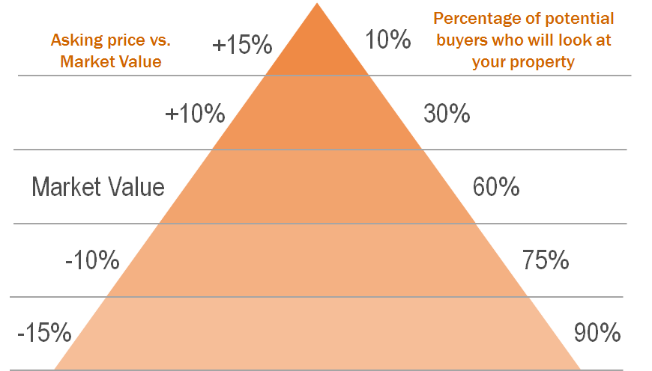
Background
Choosing the initial asking price is tough
Various strategies for selling a home:
10-15% above market value
10-15% below market value
Market Value?
Comparative Market Analysis (CMA)
Comparable Sales
https://palermolistings.com/market-data/the-great-pyramid-of-real-estate
2/9
Notes:
Before we define the problem statement, let’s start with a little background.
For home sellers and their real estate agents, setting the initial asking price for a home is often one of the most difficult stages of the selling process.
How the asking price compares to the market value of the home can have a significant impact on the number of interested buyers.
The higher the price, the fewer potential buyers will consider the property. This is often referred to as the real estate pricing pyramid.
There are a few strategies that are common:
The first is setting the asking price 10-15% above the market value. Typically, sellers might choose this strategy if they believe there is high value appeal to their home (for example, what school district it’s in, or some unique characteristic).
The second strategy is setting the asking price 10-15% BELOW the market value. Most sellers will shy away from the suggestion of listing their home for less than it’s worth. However, the merits of this strategy exist in the larger pool of potential buyers, which can drive the price up when there are multiple offers.
So, how exactly is the “market value” of a home determined?
Typically, real estate agents will perform what is called a Comparative Market Analysis.
This usually involves the real estate agent identifying a handful of similar homes that have sold recently and inferring the value of the potential listing based on what those homes sold for.

Slide 3
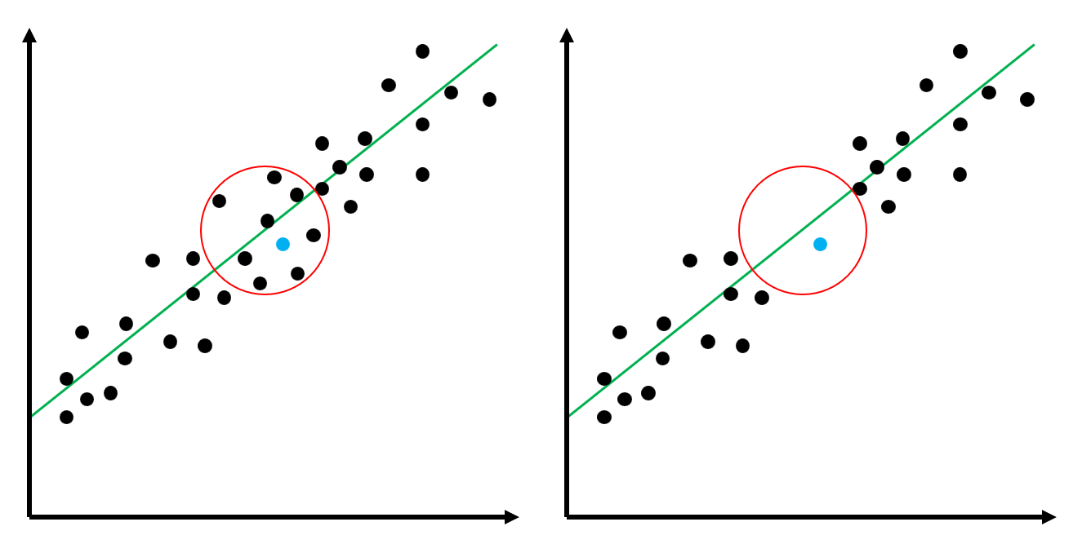
What’s the benefit?
Limited time and resources
What if there are no comparable sales?
3/9
Notes:
So, what’s the benefit of using machine learning?
Many real estate agents have limited time and resources, yet they’re trying to maximize their number of listings. Combing through multiple listing sites trying to manually look for comparable sales is time consuming.
But it’s also not always fruitful.
For example, what if there are no “comparable sales”?
This is where the modeling comes in, and we can use aggregate data and inference to approximate the value of the home.

Slide 4

Problem Statement
Can we generate a machine-learning model to help real estate agents accurately estimate a fair market value for a home?
4/9
Notes:
So the question then, is:
Can we create an accurate machine learning model to estimate a fair market value for a home, and give home sellers and their agents a reasonable baseline for dictating the initial asking price?
Let’s find out…

Slide 5
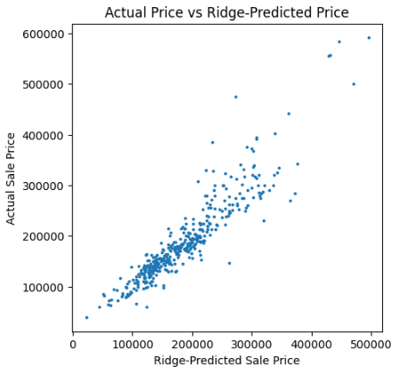
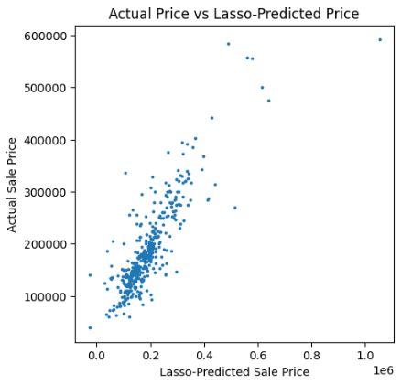
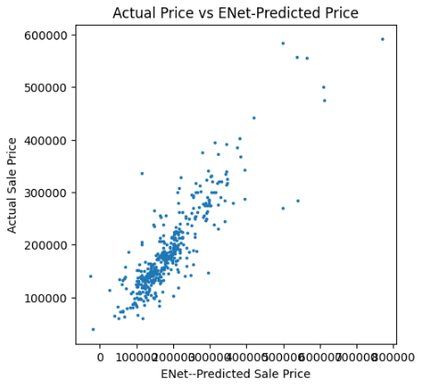
Iteration 1
5/9
Notes:
These figures show the actual sale price compared to the predicted price of the model, with the Ridge, Lasso, and ElasticNet models in order from left to right.
The first iteration of modeling was the most complex, training on 36 total features, including both numeric and categorical data.
A couple things we’re looking for here are how tightly the dots are clustered in a line, and the second would be how closely they conform to the y=x line.
*I apologize that the x-axes are not consistent across the plots. I would have corrected the axes and added a reference line with more time*
It may be a little difficult to tell between these plots, but the points get more dispersed from left to right, with the Ridge model the tightest to a line.
Spoiler: this model did end up being the best performing overall.

Slide 6
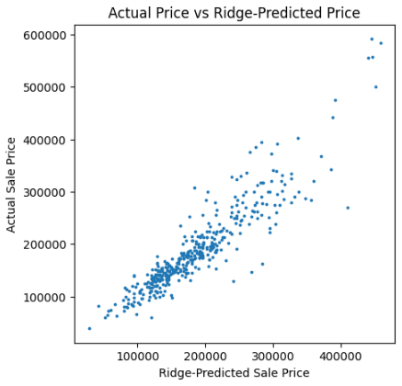
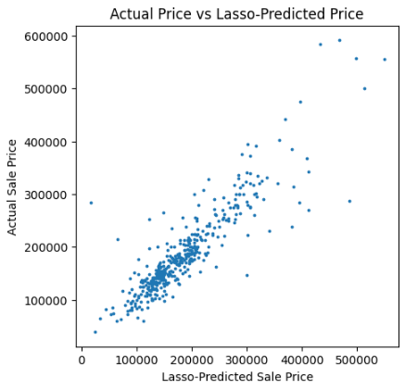

Iteration 2
6/9
Notes:
With the second iteration, I removed some of the features that exhibited collinearity, with the expectation that the models would improve.
This time, there was no major distinction that could be drawn between the models visually.

Slide 7
The numbers…
Iteration 1
Iteration 2
Model | Training Error ($) | Testing Error ($)
Ridge | 0.92 | 0.84
Lasso | 0.98 | 0.61
ElasticNet | 0.98 | 0.72
Model | Training Error ($) | Testing Error ($)
Ridge | 0.92 | 0.84
Lasso | 0.95 | 0.79
ElasticNet | 0.95 | 0.80
7/9
Notes:
So, let’s look at some of the numbers.
The training scores for each model were fairly good, all scoring above 90%.
However, what I really want to draw your attention to is their performance when applied to the test data.
With both the Lasso and ElasticNet models, the model performed significantly worse on the test data.
This tells us that these models are highly overfit, with significant variance.

Slide 8
How far off are we, really?
Using the Ridge model...
With an average home sale value of about $180,000
that’s an error between 11 – 19%
$20,000 - $35,000
7/9
Notes:
Well, how far off are we, really?
Using the Ridge model, our predictions end up being between $20,000 – 35,000 off the true sale price.
With an average home sale value of about $180,000, that’s an error between 11 – 19%.

Slide 9
Conclusions
The Ridge model is promising, however…
The error is too large
Recommendations
Deeper data cleaning
Use a different k-value for cross-validation
Collecting more data to train the model on
Including sale date
8/9
Notes:
In conclusion, the Ridge model does have promise
However, the error is just to significant for this application.
If home sellers and real estate agents are looking to price a home within 10 – 15% of the market value, we can’t have a market value that’s 10-15% off.
To improve the models and our interpretation of them, I recommend
- Performing a deeper, more methodical cleaning of the available data to remove outliers and impute missing values where reasonable.
- Using a different k-value for cross-validation. This project used a k-value of 5 across the board to maintain consistency, though 10 is another common k-value for cross-validation.
- Collecting more data to train the model on, including more recent data as well as housing data outside of Ames, IA.
- Including sale date (month/season) in the model data. This project did not look seasonal relationships to sale price, though time of year is a commonly regarded factor that impacts the value of a home.

